Slide 1
IoT (Internet of Things)
TOPIC: IoT Smart Greeting System

Slide 2
CONTENTS
Project Objective
Hardware & Software Requirements
Application Work Flow
Screenshots
Future Scope of Improvements

Slide 3
Project Objective
The primary project goals consist of:
Checking light intensity online from a sensor.
Storing the data at a particular time sent by the sensor.
Being greeted according to the Light sensed by the Light sensor.

Slide 4






Hardware Requirements
Client Side:
Processor: Intel Pentium @2.20 GHz
Internal RAM: 4 GB RAM
System Type: 64-bit operating system
Server Side:
Processor: Intel Pentium @2.20 GHz
Internal RAM: 4 GB RAM
System Type: 64-bit operating system
NODE MCU
Light Sensor (Input Card)
Jumper Wires
Software Requirements
Client Side
Server side

Slide 5


Application Work Flow
NODE MCU
INPUT CARD(LCR)
Light Sensor
DATA
SERVER
CSS File
DATA.txt
WELCOME PAGE & MAIN PAGE
(HTML)
DATA.php
LOGIN.txt
INDEX.php
(Sign in)
DATA_LOG.txt

Slide 6
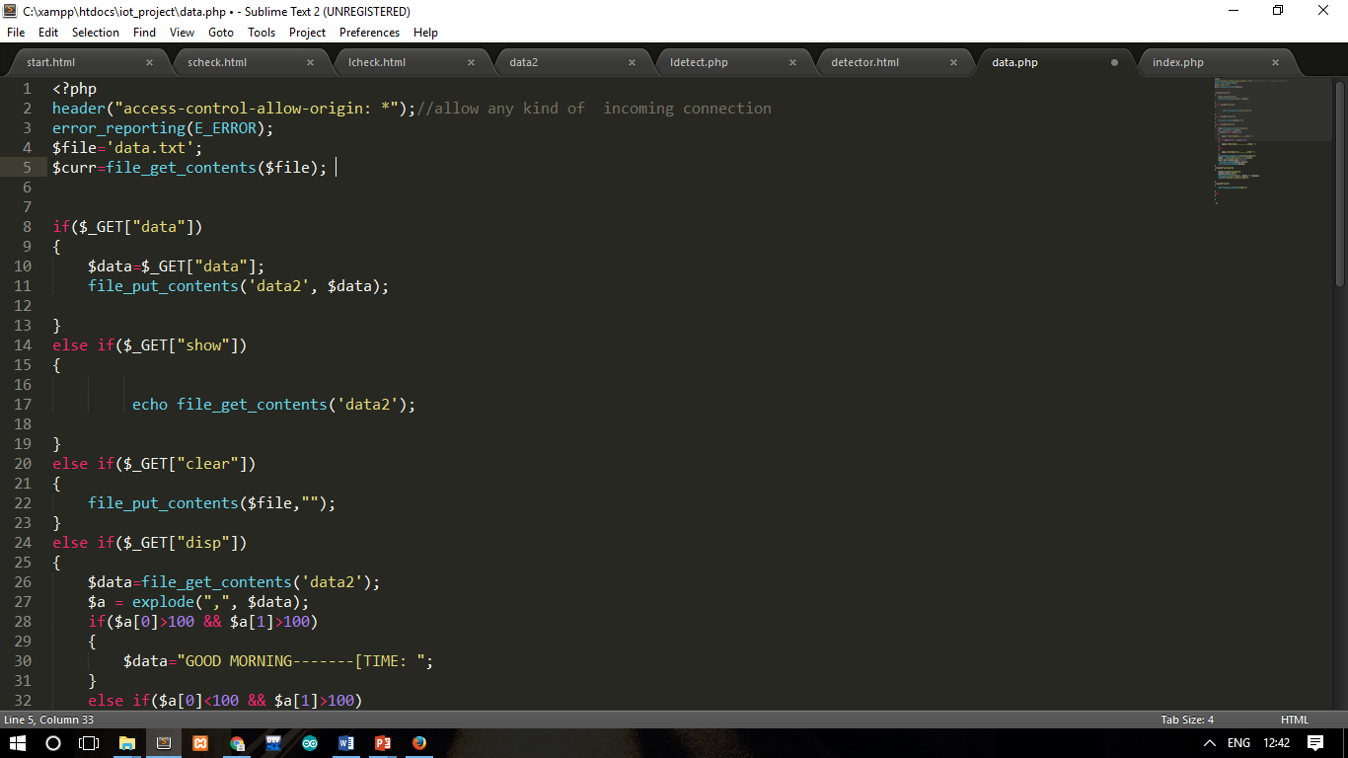
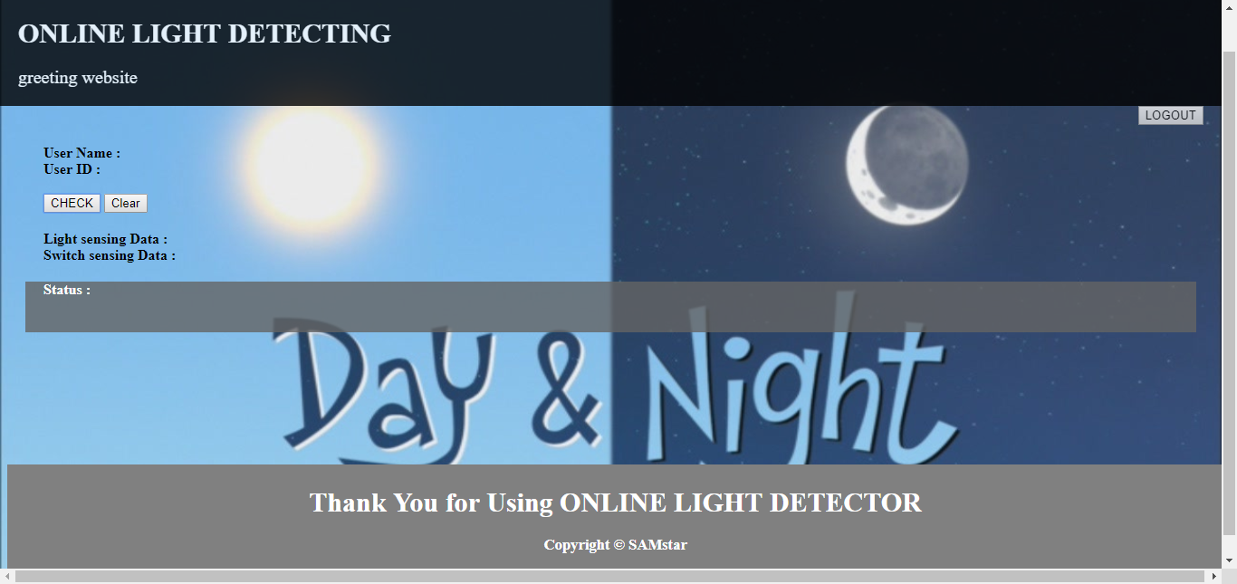
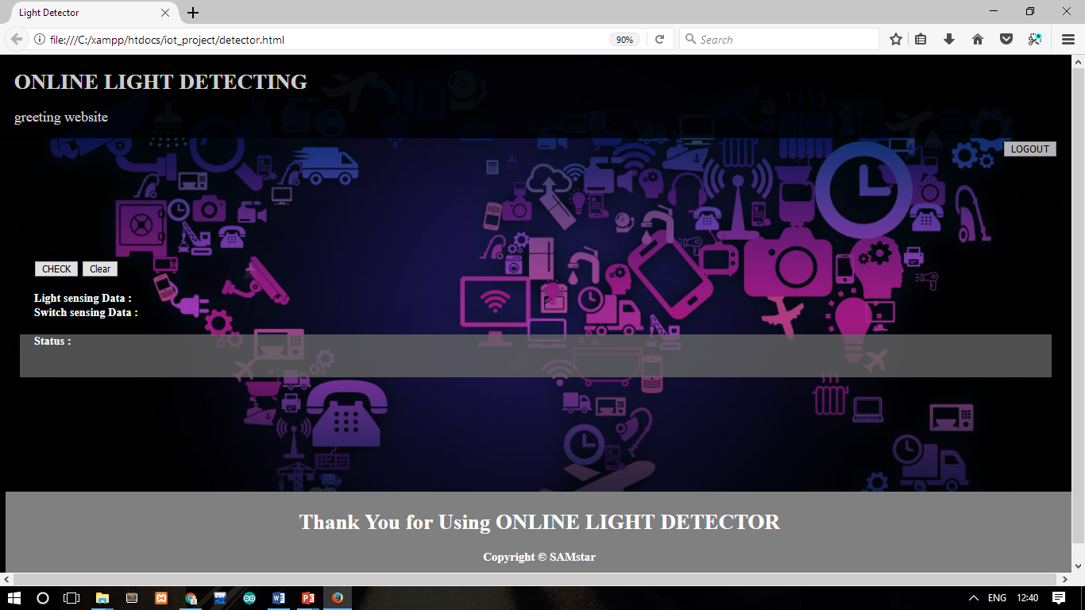
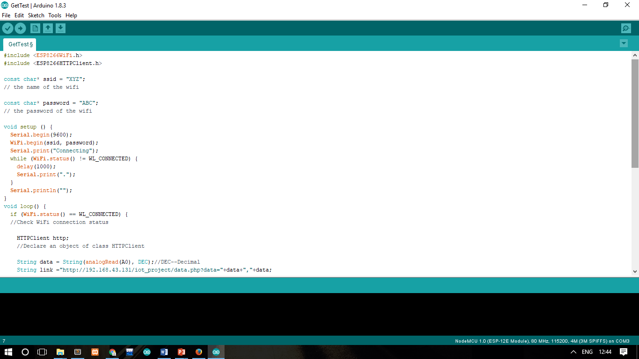
Screenshots

Slide 7
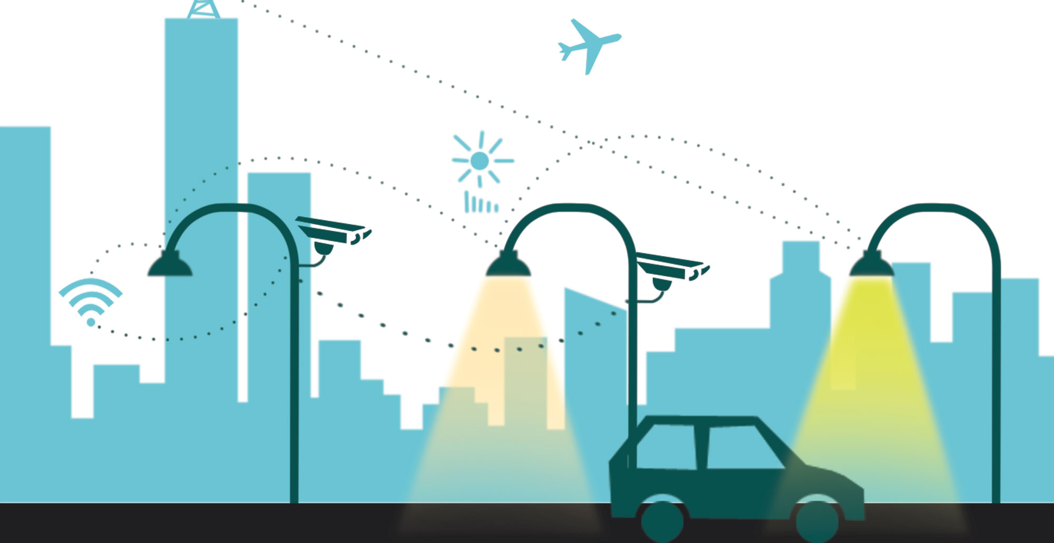
FUTURE SCOPE OF IMPROVEMENTS
The data from the sensor can be fed to a circuit which may accordingly adjust the light of the street lamps intensity which will in turn provide smart lighting on the streets as the sun light intensity can be measured by the light sensor we are using.

